Slide 1


<Name>
<Date>

Slide 2
Executive Summary
Introduction
Methodology
Results
Conclusion
Appendix
Outline

Slide 3
SUMMARY OF METHODOLOGIES
Executive Summary
Data Collection through SpaceX API
Data Collection with Web Scraping
Data Wrangling
EDA with Visualization
EDA with SQL
Building an Interactive Map with Folium
Machine Learning Prediction and Analysis
SUMMARY OF ALL RESULTS
Preliminary analysis based on EDA
Interactive Analytics with screenshots
Machine Learning Predictive analysis results

Slide 4
PROJECT BACKGROUND AND CONTEXT
SpaceX has transformed the space industry with its Falcon 9 rocket by prioritizing reusability to reduce launch costs. According to their website, a Falcon 9 launch costs around $62 million, whereas other providers, including NASA, can charge over $165 million for similar launches. One of the key factors in SpaceX's cost-saving approach is their ability to successfully land and reuse the first stage of the Falcon 9. If a new competitor, such as SpaceY, wants to challenge SpaceX in the market, it is essential to understand the success rate of first-stage landings. This project aims to analyze the available data and use machine learning to predict the success of the Falcon 9’s first-stage landing. Such insights can be invaluable for competitors looking to effectively bid against SpaceX.
Introduction
MATTERS TO EXAMINE
What factors determine if Falcon 9 will land successfully?
How does the success rate of the Falcon 9 landings compare to other rockets?
What features in the data are most influential in predicting successful lands?

Slide 5

Section 1

Slide 6
Executive Summary
Data collection methodology:
Describe how data was collected
Perform data wrangling
Describe how data was processed
Perform exploratory data analysis (EDA) using visualization and SQL
Perform interactive visual analytics using Folium and Plotly Dash
Perform predictive analysis using classification models
How to build, tune, evaluate classification models
DATA COLLECTION METHODOLOGY
Using SpaceX Rest API
Web Scrapping from Wikipedia
Methodology
PERFORM DATA WRANGLING
Data was cleaned and transformed using one-hot encoding for machine learning
PERFORM EDA USING VISUALIZATION AND SQL
Data was queried with SQL and various plots were used to show patterns in the data
PERFORM INTERACTIVE VISUAL ANALYTICS USING FOLIUM AND PLOTLY DASH
Folium was used along with Dash to build interactive maps and a dashboard
PERFORM PREDICTIVE ANALYSIS USING CLASSIFICTION MODELS
Different ML algorithms were used to find the most accurate results on the data.

Slide 7
Data Collection
For data collection, I employed the following methods:
Request and parse the SpaceX launch data using the GET request via the SpaceX Rest API
Web scrape SpaceX’s Wikipedia page for launch data using Beautiful Soup. The objective was to get the necessary tables needed from it.

Slide 8
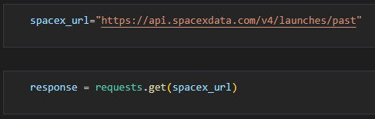
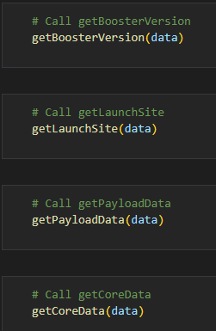
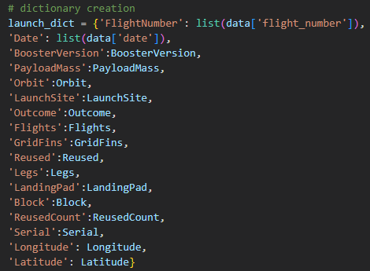
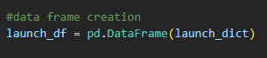
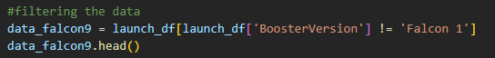
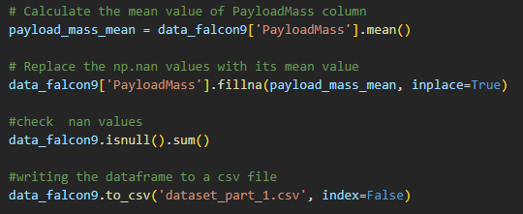
Executive Summary
Data collection methodology:
Describe how data was collected
Perform data wrangling
Describe how data was processed
Perform exploratory data analysis (EDA) using visualization and SQL
Perform interactive visual analytics using Folium and Plotly Dash
Perform predictive analysis using classification models
How to build, tune, evaluate classification models
Data Collection – SpaceX API
I used the get request to SpaceX to collect data and did some light data wrangling
Save data out to CSV file
Link to the completed notebook https://github.com/byvfx/ibm_ds_capstone/blob/main/jupyter-labs-spacex-data-collection-api.ipynb

Slide 9
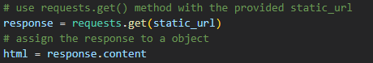
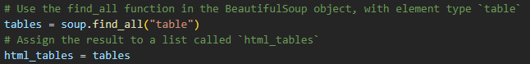
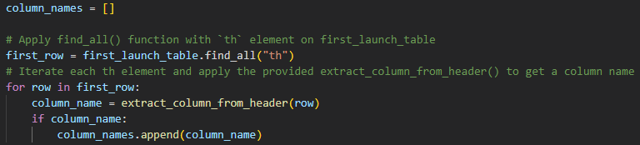
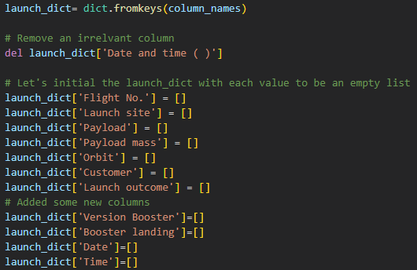
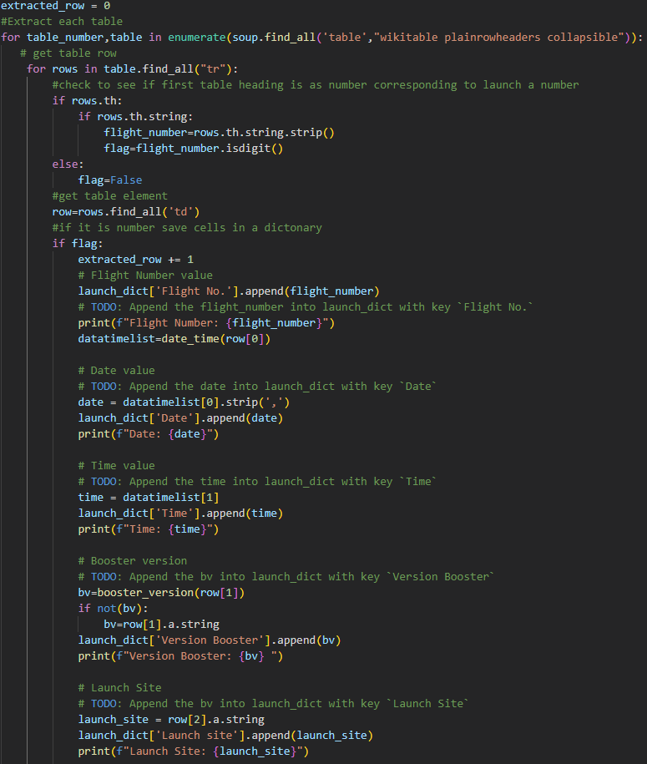
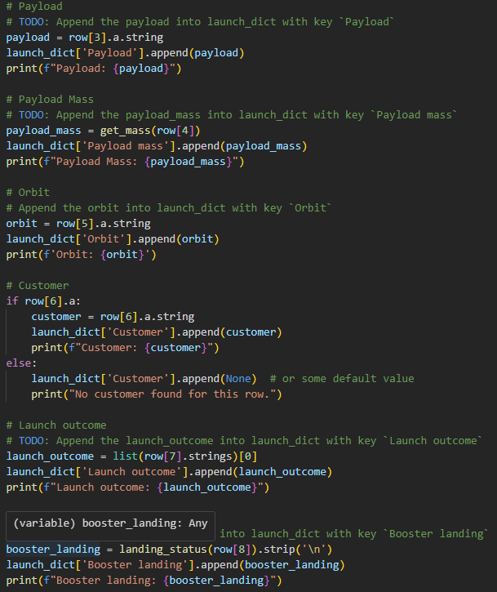
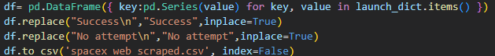
Executive Summary
Data collection methodology:
Describe how data was collected
Perform data wrangling
Describe how data was processed
Perform exploratory data analysis (EDA) using visualization and SQL
Perform interactive visual analytics using Folium and Plotly Dash
Perform predictive analysis using classification models
How to build, tune, evaluate classification models
Data Collection – Scraping
I used Beautiful Soup to scrape the data from Wikipedia
Extracted all column/variable names from the HTML table header
Created a data frame by parsing the launch HTML tables
Save data to a CSV file
Link to the completed notebook https://github.com/byvfx/ibm_ds_capstone/blob/main/jupyter-labs-webscraping.ipynb

Slide 10
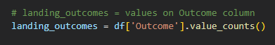
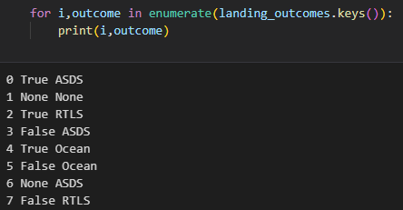
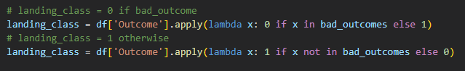
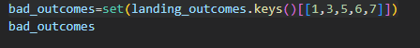
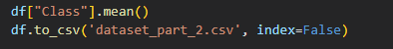
Executive Summary
Data collection methodology:
Describe how data was collected
Perform data wrangling
Describe how data was processed
Perform exploratory data analysis (EDA) using visualization and SQL
Perform interactive visual analytics using Folium and Plotly Dash
Perform predictive analysis using classification models
How to build, tune, evaluate classification models
Data Wrangling
With the data from the SpaceX API I needed to do the following:
Calculate the number of launches on each site
Calculate the number and occurrence of each orbit
Calculate the number and occurrence of mission outcome of the orbits
Create a landing outcome label from the ‘Outcome’ column, classifying it as successful or failure.
Save data to a CSV file
Link to the completed notebook https://github.com/byvfx/ibm_ds_capstone/blob/main/labs-jupyter-spacex-Data%20wrangling.ipynb

Slide 11
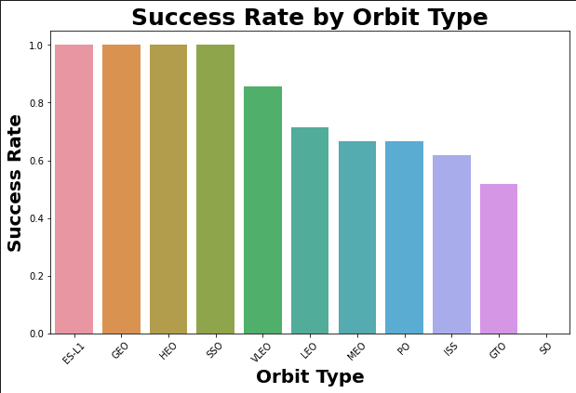
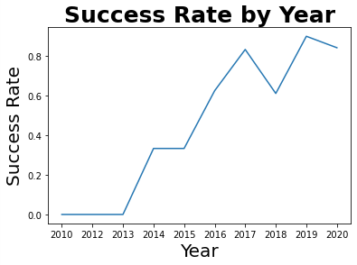
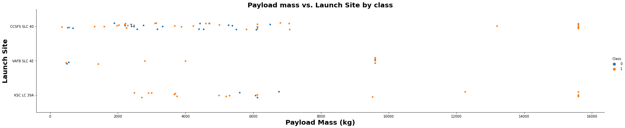
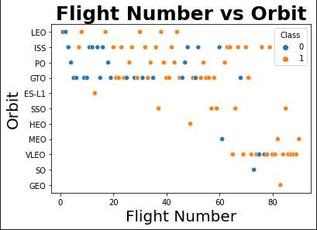
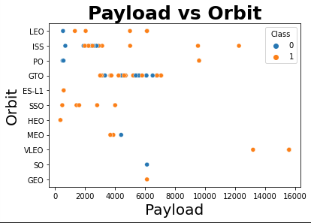
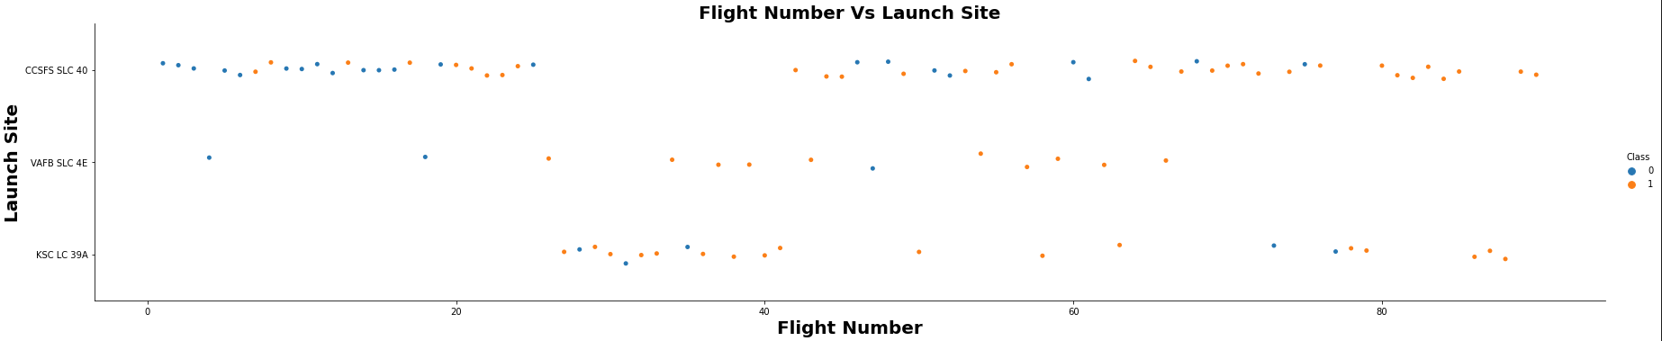
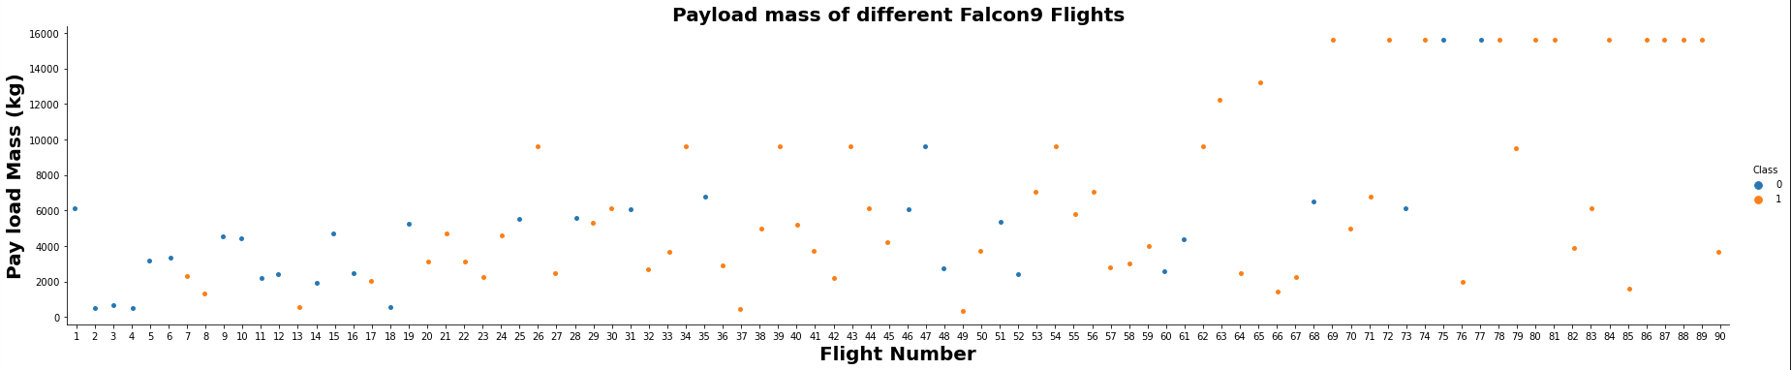
Executive Summary
Data collection methodology:
Describe how data was collected
Perform data wrangling
Describe how data was processed
Perform exploratory data analysis (EDA) using visualization and SQL
Perform interactive visual analytics using Folium and Plotly Dash
Perform predictive analysis using classification models
How to build, tune, evaluate classification models
EDA with Data Visualization
I explored the data relationship between flight number, launch site, payload and success rate of each orbit type, and the launch success yearly trend.
Link to the completed notebook https://github.com/byvfx/ibm_ds_capstone/blob/main/jupyter-labs-eda-dataviz.ipynb

Slide 12
Executive Summary
Data collection methodology:
Describe how data was collected
Perform data wrangling
Describe how data was processed
Perform exploratory data analysis (EDA) using visualization and SQL
Perform interactive visual analytics using Folium and Plotly Dash
Perform predictive analysis using classification models
How to build, tune, evaluate classification models
SQL QUERIES PERFORMED
Display the names of the unique launch sites in the space mission
Display 5 records where launch sites begin with the string 'CCA'
Display the total payload mass carried by boosters launched by NASA (CRS)
Display average payload mass carried by booster version F9 v1.1
List the date when the first successful landing outcome in the ground pad was achieved.
List the total number of successful and failed mission outcomes
List the names of the booster_versions which have carried the maximum payload mass. Use a subquery
List the records which will display the month names, failure landing_outcomes in drone ship ,booster versions, launch_site for the months in year 2015
Rank the count of landing outcomes (such as Failure (drone ship) or Success (ground pad)) between the date 2010-06-04 and 2017-03-20, in descending order
EDA with SQL
Link to the completed notebook https://github.com/byvfx/ibm_ds_capstone/blob/main/jupyter-labs-eda-sql-coursera_sqllite.ipynb

Slide 13
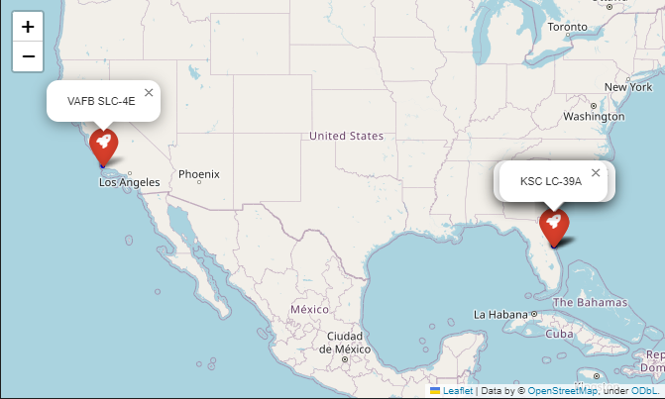
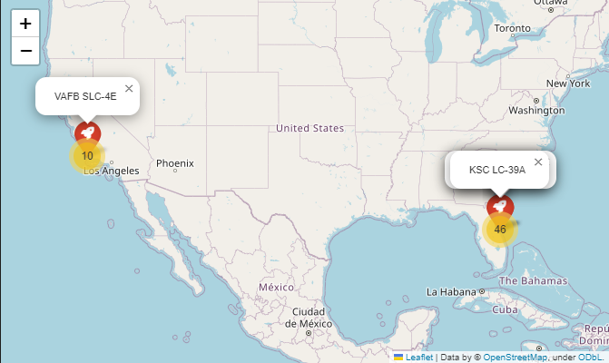
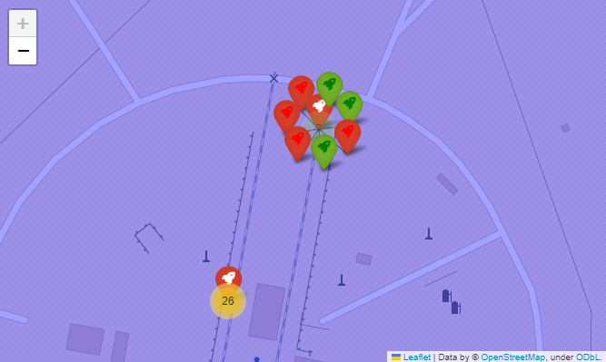
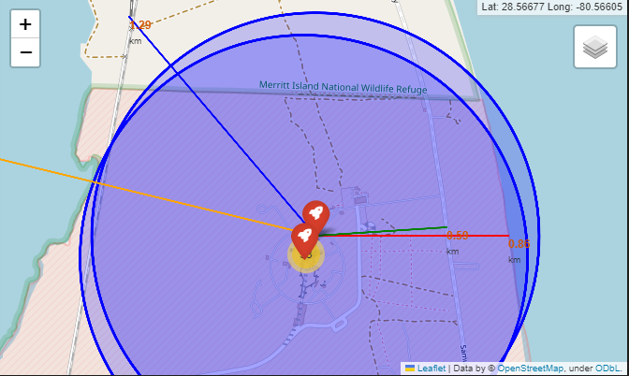
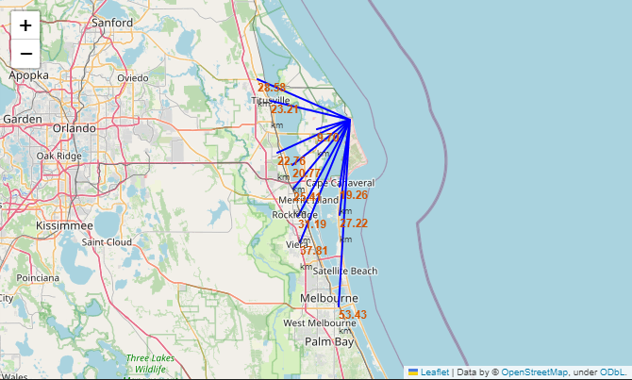
Executive Summary
Data collection methodology:
Describe how data was collected
Perform data wrangling
Describe how data was processed
Perform exploratory data analysis (EDA) using visualization and SQL
Perform interactive visual analytics using Folium and Plotly Dash
Perform predictive analysis using classification models
How to build, tune, evaluate classification models
Build an Interactive Map with Folium
We marked where rockets launch on a map.
We used different symbols on the map to show whether a rocket launch was successful.
We gave each launch a label: 0 means it failed, and 1 means it was successful.
We grouped launch sites by color to see which ones succeed more often.
We looked at launch sites’ proximity to things like train tracks, roads, and the ocean.
We checked if the launch sites are far from cities.
Link to the completed notebook https://github.com/byvfx/ibm_ds_capstone/blob/main/lab_jupyter_launch_site_location.ipynb

Slide 14
Executive Summary
Data collection methodology:
Describe how data was collected
Perform data wrangling
Describe how data was processed
Perform exploratory data analysis (EDA) using visualization and SQL
Perform interactive visual analytics using Folium and Plotly Dash
Perform predictive analysis using classification models
How to build, tune, evaluate classification models
PIE CHART
It shows the success rate of all launch sites.
It displays the proportion of success and failures of given launch site.
Build a dashboard with plotly dash
SCATTER PLOT
It shows the correlation between mission outcome and payload mass for different booster versions for all sites or selected site.
The payload mass can be filter by weight range using the slider control.
Link to the completed notebook https://github.com/byvfx/ibm_ds_capstone/blob/main/dash_spacex_lab.py

Slide 15
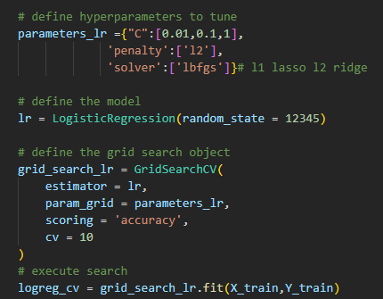
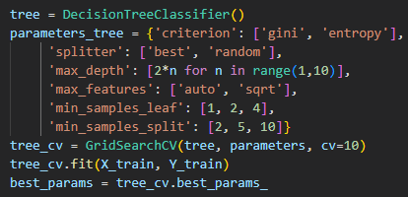
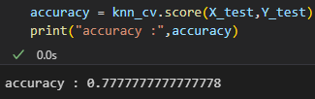
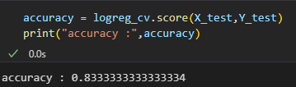
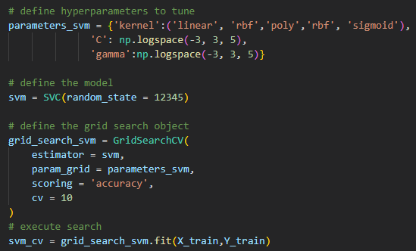
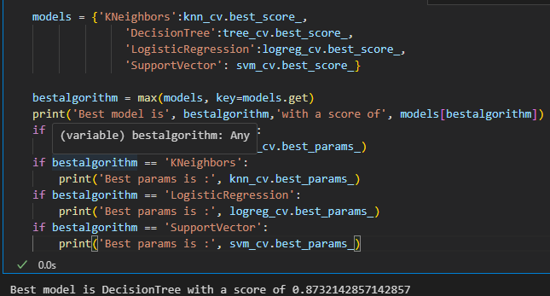
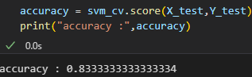
Predictive Analysis (Classification)
I loaded in the data using numpy and pandas, transformed the data, split out data into training and testing.
I built different machine-learning models and tuned different hyperparameters using GridSearch CV.
I used accuracy as the metric for our model improved the model using feature engineering and algorithm tuning.
I found the best-performing classification model. Which was the decision tree
Link to the completed notebook https://github.com/byvfx/ibm_ds_capstone/blob/main/SpaceX_Machine_Learning_Prediction_Part_5.jupyterlite.ipynb

Slide 16
Results
Exploratory data analysis results
Interactive analytics demo in screenshots
Predictive analysis results

Slide 17

Section 2

Slide 18
Flight Number vs. Launch Site
More recent missions have higher success rates at all launch sites
There's an apparent trend where certain launch sites are more commonly used during specific flight number ranges.
There seems to be a transition from more Class 0 flights to more Class 1 flights as the flight numbers increase.

Slide 19
Payload vs. Launch Site
There isn't a strong linear correlation between payload mass and launch success or failure for individual launch sites based on the visual inspection.
All launch sites have both successful and unsuccessful launches (Class 0 and Class 1) across various payload masses.

Slide 20
Payload vs. Launch Site
There isn't a strong linear correlation between payload mass and launch success or failure for individual launch sites based on the visual inspection.
All launch sites have both successful and unsuccessful launches (Class 0 and Class 1) across various payload masses.

Slide 21
Success Rate vs Orbit Type
The chart shows different orbit types have varying levels of launch success rates, with ESI-L1 and GEO achieving almost perfect success, while SSO orbits experience the least success.

Slide 22
Flight Number vs. Orbit
Orbit types like LEO and ISS have a higher frequency of launches across a broad range of flight numbers, while others like HEO, SO, and GEO have fewer launches.

Slide 23
Payload vs. Orbit Type
Some orbit types, like LEO and ISS, mainly deal with lighter payloads, while others, like MEO, handle heavier ones. Both success and failure outcomes are present across the different payload ranges for various orbits.

Slide 24
Launch Success Yearly Trend
Over the years we can see that the success rate has steadily climbed

Slide 25
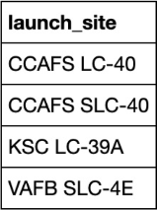
All Launch Site Names
SQL Query
"SELECT DISTINCT Launch_Site FROM SPACEXTBL;
Query Result
Explanation
We are looking for names with unique launch site names in the Spacex table
Using select distinct statement to retrieve the unique launch site names

Slide 26
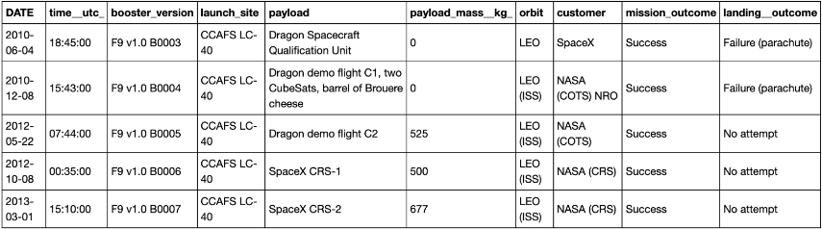
Launch Site Names Begin with 'CCA'
SQL Query
SELECT * FROM SPACEXTBL
WHERE Launch_Site
LIKE 'CCA%’ limit 5;
Query Result
Explanation
We are looking for records that begin with CCA with a limit of 5
Using the like operator to search a specific pattern and using the limit clause to retrieve on 5 records

Slide 27
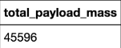
Total Payload Mass
SQL Query
SELECT Customer, SUM(PAYLOAD_MASS__KG_)
FROM SPACEXTBL
WHERE Customer = 'NASA (CRS)';
Query Result
Explanation
We are looking for the total payload mass carried by the booster launched by NASA (CRS)
Using the sum function to return the total and then using the condition customer = NASA CRS to filter the records

Slide 28
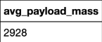
Average Payload Mass by F9 v1.1
SQL Query
SELECT Booster_Version, AVG(PAYLOAD_MASS__KG_)
AS avg_payload_mass
FROM SPACEXTBL
WHERE Booster_Version = 'F9 v1.1';
Query Result
Explanation
We are looking for the average payload mass of the F9 v1.1 rocket
Using the avg function to return the mean and then using the condition booster_version = F9 v1.1 to filter the records

Slide 29
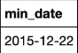
First Successful Ground Landing Date
SQL Query
SELECT MIN(Date)
FROM SPACEXTBL
WHERE Landing_Outcome = 'Success (ground pad)';
Query Result
Explanation
We are looking for the first occurrence of a successful landing on the ground pan
Using the min function to return the first date and then using the condition Landing_Outcome = Success (ground pad) to filter the records

Slide 30

First Successful Ground Landing Date
Find the dates of the first successful landing outcome on ground pad
Present your query result with a short explanation here

Slide 31
Successful Drone Ship Landing with Payload between 4000 and 6000
List the names of boosters which have successfully landed on drone ship and had payload mass greater than 4000 but less than 6000
Present your query result with a short explanation here

Slide 32
Total Number of Successful and Failure Mission Outcomes
Calculate the total number of successful and failure mission outcomes
Present your query result with a short explanation here

Slide 33
Boosters Carried Maximum Payload
List the names of the booster which have carried the maximum payload mass
Present your query result with a short explanation here

Slide 34
2015 Launch Records
List the failed landing_outcomes in drone ship, their booster versions, and launch site names for in year 2015
Present your query result with a short explanation here

Slide 35
Rank Landing Outcomes Between 2010-06-04 and 2017-03-20
Rank the count of landing outcomes (such as Failure (drone ship) or Success (ground pad)) between the date 2010-06-04 and 2017-03-20, in descending order
Present your query result with a short explanation here

Slide 36

Section 3

Slide 37
<Folium Map Screenshot 1>
Replace <Folium map screenshot 1> title with an appropriate title
Explore the generated folium map and make a proper screenshot to include all launch sites’ location markers on a global map
Explain the important elements and findings on the screenshot

Slide 38
<Folium Map Screenshot 2>
Replace <Folium map screenshot 2> title with an appropriate title
Explore the folium map and make a proper screenshot to show the color-labeled launch outcomes on the map
Explain the important elements and findings on the screenshot

Slide 39
<Folium Map Screenshot 3>
Replace <Folium map screenshot 3> title with an appropriate title
Explore the generated folium map and show the screenshot of a selected launch site to its proximities such as railway, highway, coastline, with distance calculated and displayed
Explain the important elements and findings on the screenshot

Slide 40

Section 4

Slide 41
<Dashboard Screenshot 1>
Replace <Dashboard screenshot 1> title with an appropriate title
Show the screenshot of launch success count for all sites, in a piechart
Explain the important elements and findings on the screenshot

Slide 42
<Dashboard Screenshot 2>
Replace <Dashboard screenshot 2> title with an appropriate title
Show the screenshot of the piechart for the launch site with highest launch success ratio
Explain the important elements and findings on the screenshot

Slide 43
<Dashboard Screenshot 3>
Replace <Dashboard screenshot 3> title with an appropriate title
Show screenshots of Payload vs. Launch Outcome scatter plot for all sites, with different payload selected in the range slider
Explain the important elements and findings on the screenshot, such as which payload range or booster version have the largest success rate, etc.

Slide 44

Section 5

Slide 45
Classification Accuracy
Visualize the built model accuracy for all built classification models, in a bar chart
Find which model has the highest classification accuracy

Slide 46
Confusion Matrix
Show the confusion matrix of the best performing model with an explanation

Slide 47
Conclusions
Point 1
Point 2
Point 3
Point 4
…

Slide 48
Appendix
Include any relevant assets like Python code snippets, SQL queries, charts, Notebook outputs, or data sets that you may have created during this project

Slide 49


